Slide 1

Business Plan
by
Ammar Khan
Song Young Woong
Notes:
To change the image on this slide, select the picture and delete it. Then click the Pictures icon in the placeholder to insert your own image.

Slide 2
About Book Hive:
A cloud based E-Book deployment system to make books available everywhere.
Accessible from any smartphone, tablet or a computer.
No need to download or buy individual book ,system provides viewing mode itself.

Slide 3
Book Hive Solutions for Customers:
Book Hive is going to solve the problem of providing books everywhere you go.
Books are expensive to buy and becomes only a collectible once you have read it. Book Hive will provide books of broad spectrum on monthly subscription.
Book Hive is going to help those who are struggling to find quality books in the libraries and the environment isn’t suitable for them.
It is going to save a lot of paper waste created by book printing.
All these only for 10$/month.

Slide 4
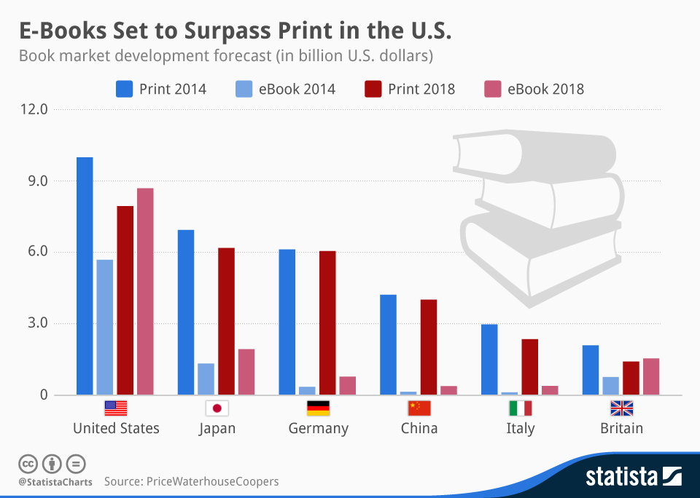
Print Books vs E-Book Market:
The technology has already replaced conventional book printing method by a large factor but has failed to provide it with the latest standards of Cloud Computing deployment. Book Hive is going to be a bleeding edge technology to make the current technology incorporated obsolete.

Slide 5
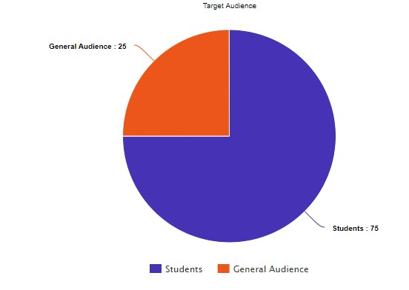
Target Audience:

Slide 6
Book Hive Working:
Signup
Subscribe
Login
Start Reading

Slide 7
Setup Requirement:
Book Hive initially requires a full fledge server grade computer machine along with redundant internet connections capable of handling large bandwidth requirements.
The setups accompanies open source software from Ubooquity along with adjustments and load balancing and servicing infrastructure techniques.
Customers can pay for their monthly subscriptions via Easy-Paisa and PayPal which will cover both Pakistan and Global Scope.

Slide 8
One Time Cost:
Synology DS218j Network Storage DiskStation $169
Two RAID-1 4 TB drives $185
Total: $380

Slide 9
Monthly Cost:
Two redundant 20Mb/sec internet connections by PTCL $60/month
Static IP charges $4/month
Total: $64/month

Slide 10
Cost Balancing and Investment Recovery:
At least 7 subscribers are required to run the business in no profit/loss situation.
With average 20 subscribers monthly (estimating minimum), the business investment is intended to be recovered in 2 months.

Slide 11
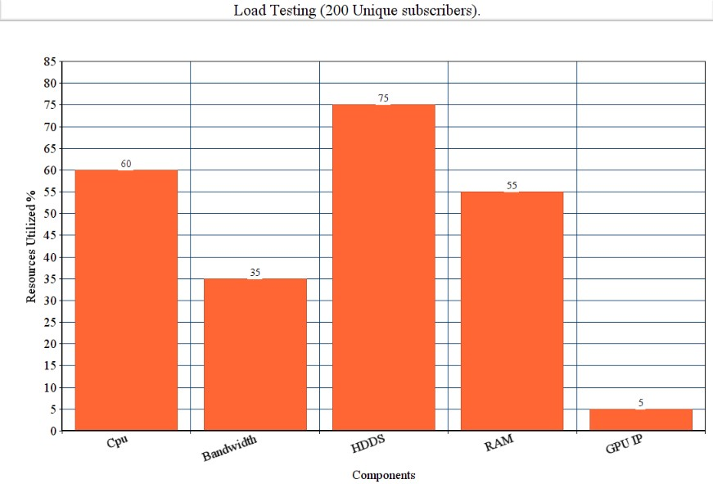
Add a Slide Title - 4

Slide 12

User Interface: Main Menu

Slide 13
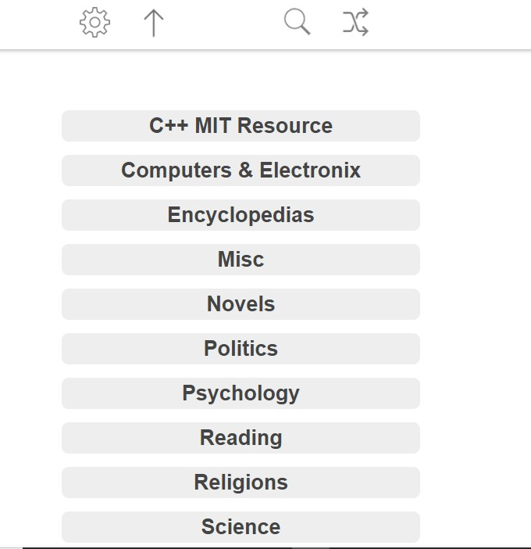
User Interface: Categories

Slide 14
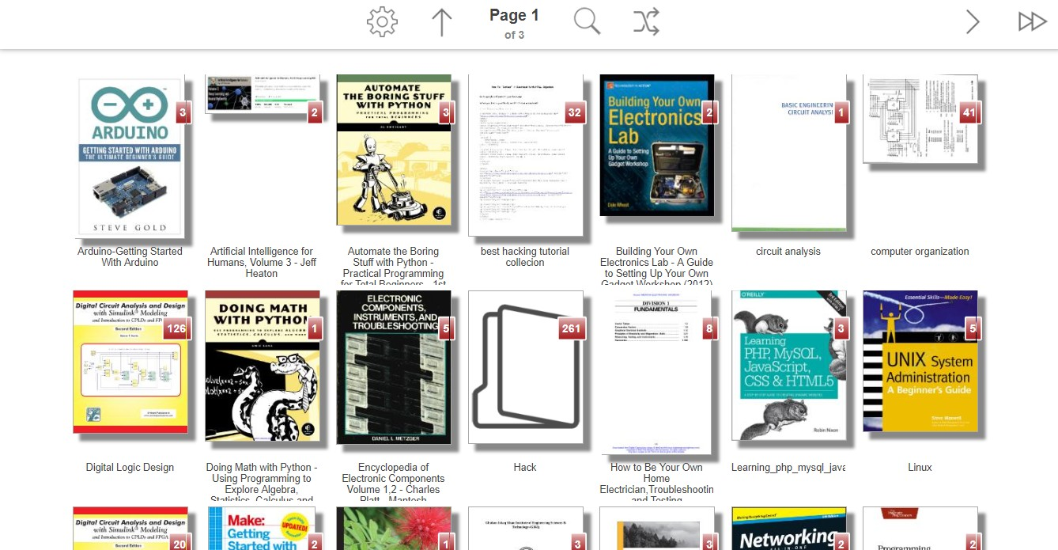
User Interface: Book Selection

Slide 15
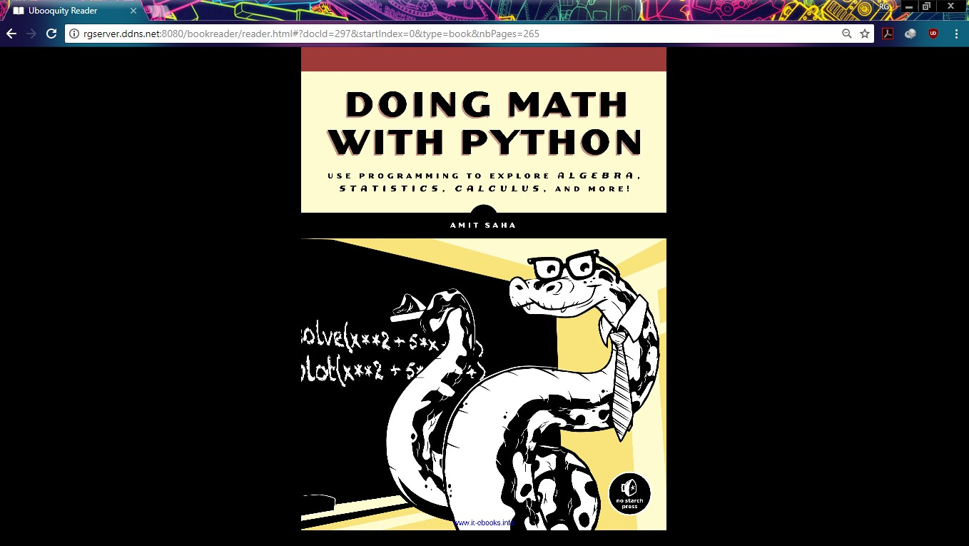
User Interface: Reading Mode

Slide 16
References:
www.statista.com/topics/1177/book-market/
www.statista.com/markets/417/topic/477/books-publishing/
www.internationalpublishers.org/market-insights/data-and-statistics

